Slide 1
Breaking RSA to Pop Shells
with avantika
Notes:
hello hackers Crypto joke
Story timeline

Slide 2
~# whoami
avantika (@iamavu)
a girl who dabbles in security
makes music sometimes
loves memes :D
Notes:
Make it interactive statement
OSINT joke

Slide 3
what we hacking today?
enumeration
symmetric encryption
asymmetric encryption
rsa
maths
python scripting
fermat attack
Notes:
what’s in it for them

Slide 4
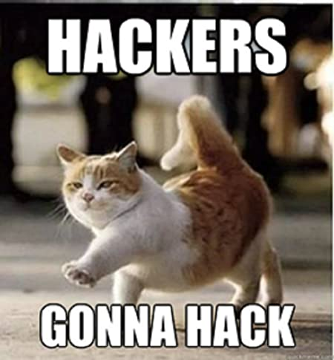
enumerate me too
enumerate
enumerate
enumerate
….
….
….
….
enumerate
Notes:
Talk about methodology, tools
Example if i know php based application
Be smart
Tools aren’t meant to do your job, they are meant to assist you in your job
nmap scan

Slide 5
demo s1

Slide 6
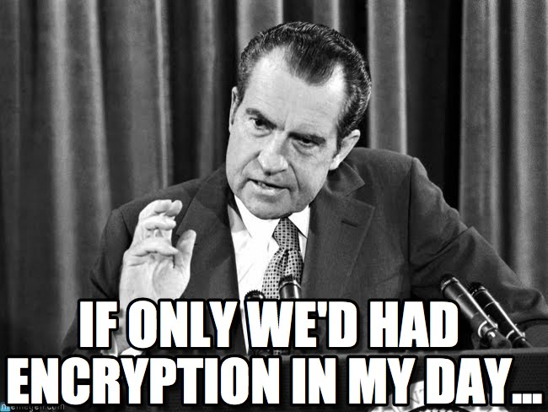
public key? what’s that?
Notes:
Talk about encryption(secure encoding), encoding ( information representation jwt b64 no security), hashing (one way function)

Slide 7
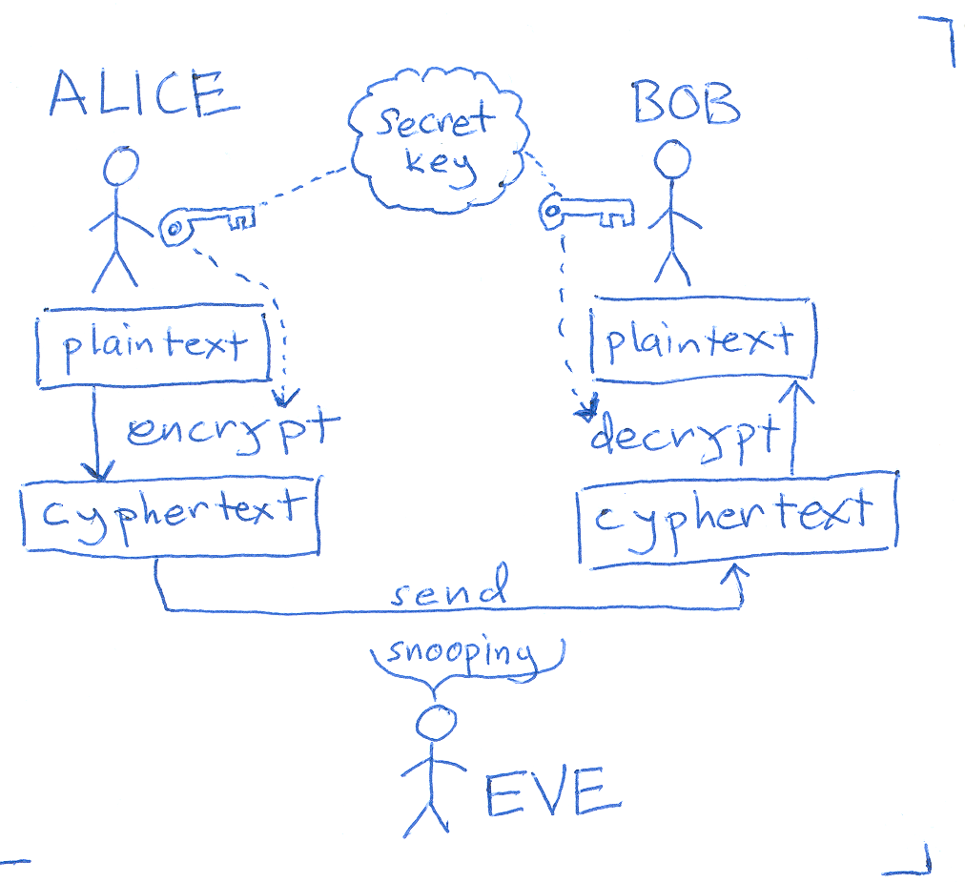
learn with bob,alice and eve season 1 : symmetric encryption

Slide 8
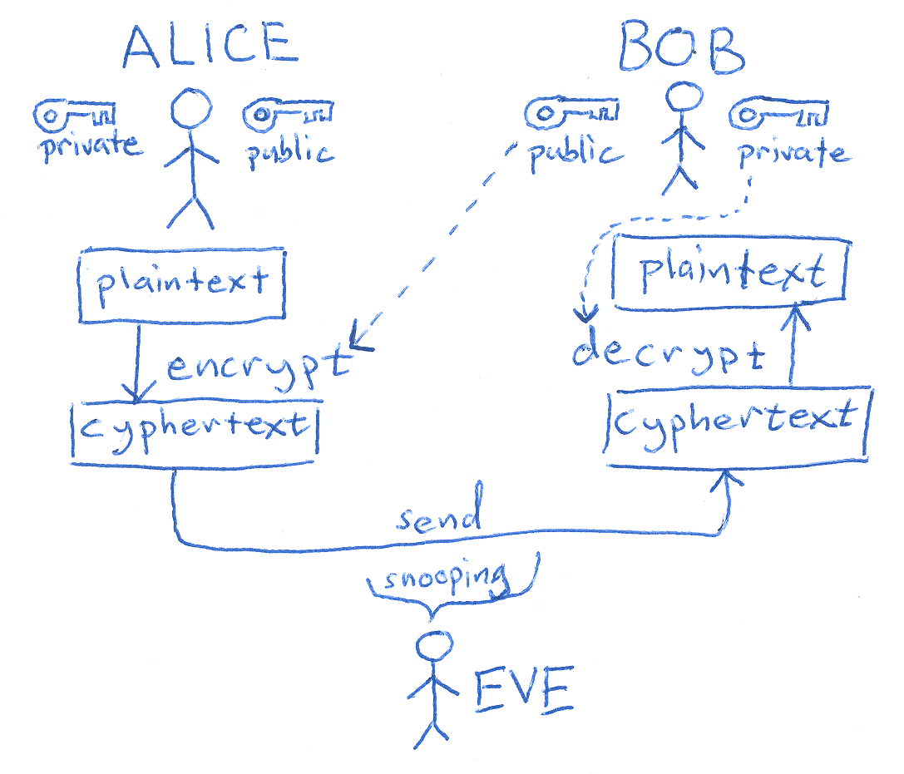
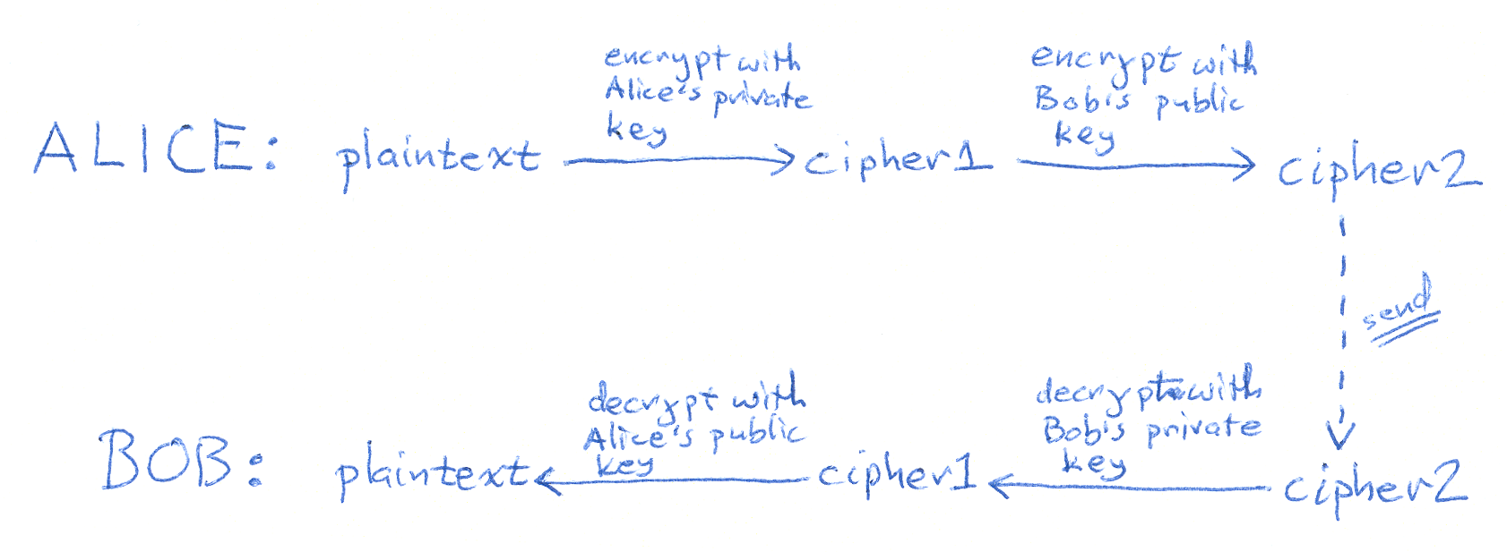
learn with bob,alice and eve season 2 : asymmetric encryption

Slide 9
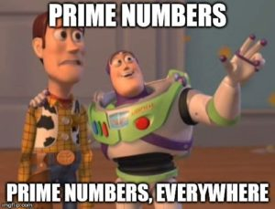
prime numbers that keep your messages safe
select two primes (p & q)
multiply primes to get n (modulus)
select e, non-factor integer of n (usually 65537)
public key == (n, e)
calculate phi = (p - 1) * (q - 1)
find d such that d * e = 1 % phi
private key == (d)
Notes:
Talk about rsa (Rivest Shamir Adleman)
Explain the basics without too much going in depth

Slide 10
demo s2

Slide 11
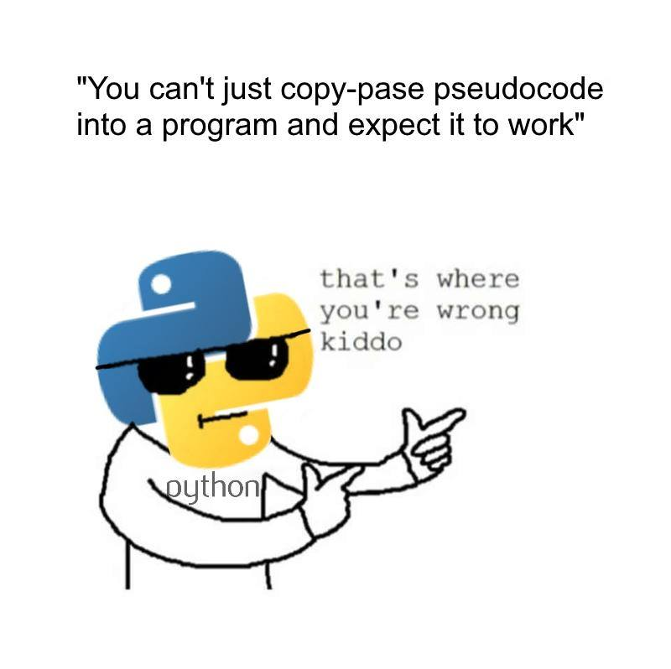
script me up mom!
easy as it is almost english
great community support
amazing modules/libraries

Slide 12
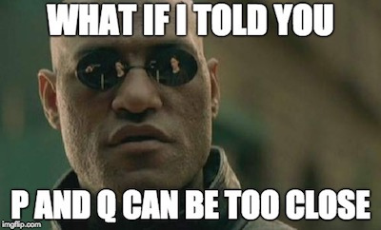
attack it with fermat
n = a² + b²
n = (a + b) * (a - b)
a ≈ √n
p == a
q == n / a
Notes:
Two large primes can be

Slide 13
demo finale

Slide 14

it is raining shells

Slide 15

r/ask_me_anything

